Slide 1
CHAPTER TWO
THEORY OF DEMAND AND SUPPLY

Slide 2
Chapter Objectives
Understand the concept of demand and the factors affecting it;
Explain the supply side of a market and the determinants of supply;
understand how the market reaches equilibrium condition, and the possible factors that could cause a change in equilibrium and
explain the elasticity of demand and supply

Slide 3
2.1 Theory of demand
Demand is one of the forces determining prices.
Related to the economic activities of consumers-consumption.
Demand implies more than a mere desire to purchase a commodity.
It states that the consumer must be willing and able to purchase the commodity, which he/she desires.
His/her desire should be backed by his/her purchasing power.
Demand, thus, means the desire of the consumer for a commodity backed by purchasing power.
Demand is an effective desire

Slide 4
Therefore a desire become an effective desire(demand only when it is backed by
Willingness to pay
Ability to pay for the good desired
Availability of the good
More specifically, demand refers to various quantities of a commodity or service that a consumer would purchase at a given time in a market at various prices, given other things unchanged (ceteris paribus).

Slide 5
Law of demand: is a principle of demand which states that , ceteris paribus, price of a commodity and its quantity demanded are inversely related
It is the basis for the downward sloping demand curve
Note- Demand and quantity demanded are two different concepts.
Whereas demand refers to the relationship between the price of a commodity and its quantity demanded, other things being same
the quantity demanded refers to a specific quantity which a consumer is willing to buy at a specific price.

Slide 6
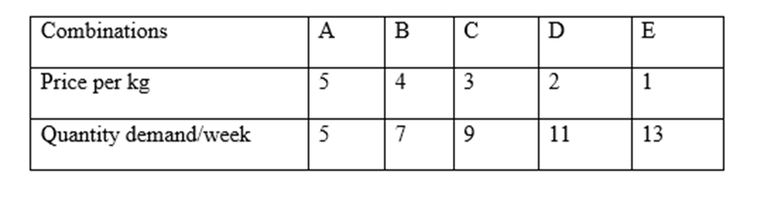
Demand schedule (table),curve and function
The relationship that exists between price and the amount of a commodity purchased can be represented by a table (schedule) or a curve or an equation.
An individual demand schedule is a list of the various quantities of a commodity, which an individual consumer purchases at various levels of prices in the market.
Is tabular statement that states the different quantities of a commodity that would be demanded at different prices

Slide 7
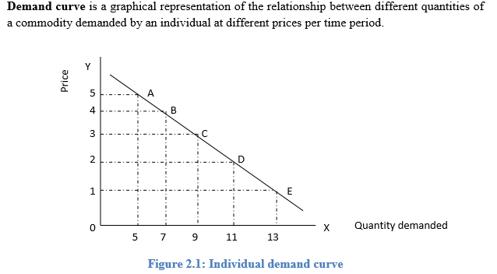

Slide 8
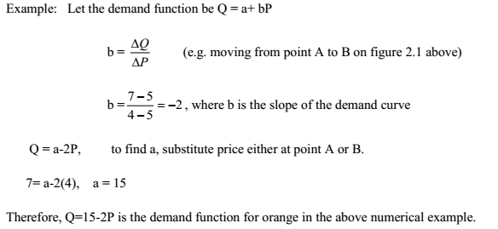
Demand function is a mathematical relationship between price and quantity demanded, all other things remaining the same.
A typical demand function is given by: Qd=f(P)

Slide 9
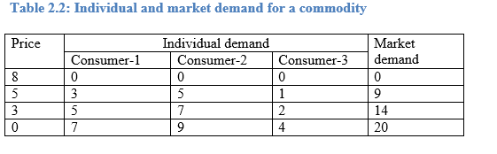
Individual Vs Market Demand:
are not identical.
The market demand schedule, curve or function is derived by horizontally adding the quantity demanded for the product by all buyers(individual demands) at each price.

Slide 10
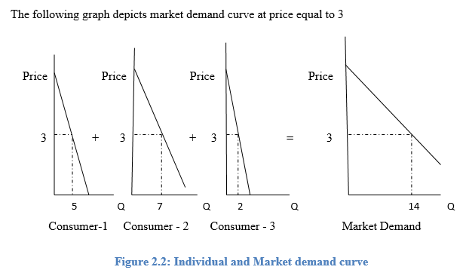
Numerical Example: Suppose the individual demand function of a product is given by: P=10 - Q /2 and there are about 100 identical buyers in the market. Then the market demand function is given by:
P= 10 - Q /2 ↔ Q /2 =10-P ↔ Q= 20 - 2P and
Qm = (20 – 2P) 100 = 2000-200P

Slide 11
Determinants of Demand
I. Price of the product
II. Taste or preference of consumers
III. Income of the consumers
IV. Price of related goods
V. Consumers expectation of income and price
VI. Number of buyers in the market etc.
i) Price of the good is the most important factor affecting demand for a commodity.
Ceteris paribus, if P increases Quantity demanded decreases, while if P decreases, quantity demanded increases.
That is change in Price of the good, causes change in quantity demanded, Hence only a movement along the same demand curve. Upward and downward movement.

Slide 12
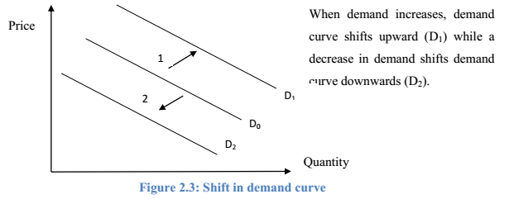
A change in any of the above listed factors except the price of the good will change the demand, while a change in the price, other factors remain constant will bring change in quantity demanded.
A change in demand will shift the demand curve from its original location. demand shifters.

Slide 13
Let us examine how each factor affect demand.
I. Taste or preference
When the taste of a consumer changes in favour of a good, her/his demand will increase and the opposite is true.
II. Income of the consumer
Generally when income increases, demand also increases, however an increase in come doesn’t invariably leads to an increase in demand for all the commodities, it depends on the nature of the commodity.
Normal Goods are goods whose demand increases as income increase-, while
inferior goods are those whose demand is inversely related with income-poor quality goods, whose buyers are expected to shift to normal goods as their income increases.

Slide 14
III Price of related goods
Two goods are said to be related if a change in the price of one good affects the demand for another good.
Substitute goods are goods, which can be used in place of each other, to satisfy the same desire of the consumer.
Ex. tea and coffee or Paepsi and Coca-Cola.
If two goods are substitutes, then price of one and the demand for the other are directly related.
Complimentary goods goods which are jointly consumed to satisfy a given want.
Ex. car and fuel or tea and sugar.
If two goods are complements, then price of one and the demand for the other are inversely related.

Slide 15
IV. Consumer expectation of price
Higher price expectation will increase demand while a lower future price expectation will decrease the demand for the good.
V. Number of buyer in the market
Since market demand is the horizontal sum of individual demand, an increase in the number of buyers will increase demand while a decrease in the number of buyers will decrease demand.

Slide 16
Elasticity of demand
is a measure of responsiveness(sensetivity) of a dependent variable to changes in an independent variable.
Elasticity of demand refers to the degree of responsiveness of quantity demanded of a good to a change in its price, or change in income, or change in prices of related goods.
1) Price Elasticity of Demand
degree of responsiveness of demand to change in price.
indicates how consumers react to changes in price.
how much the quantity demanded of a good responds to a change in the price of that good.
The greater the reaction the greater will be the elasticity, and the lesser the reaction, the smaller will be the elasticity.

Slide 17

Demand for commodities like clothes, fruit etc. changes when there is even a small change in their price, whereas
Demand for commodities which are basic necessities of life like salt, food grains etc., may not change even if price changes, or it may change, but not in proportion to the change in price.
computed as the percentage change in quantity demanded divided by the percentage change in price.
can be measured in two ways.

Slide 18



a. Point Price Elasticity of Demand
calculated to find elasticity at a given point.
Example- The demand for tickets to an Ethiopian Camparada film is given by D(p)= 200,000- 10,000p, where p is the price of tickets. If the price of tickets is 12 birr, calculate price elasticity of demand for tickets and draw the demand curve.
b. Arc price elasticity of demand
Between the two points.

Slide 19
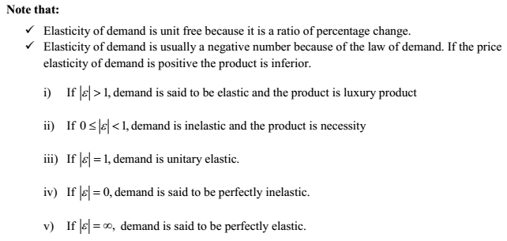
Suppose that the price of a commodity is Br. 5 and the quantity demanded at that price is 100 units of a commodity. Now assume that the price of the commodity falls to Br. 4 and the quantity demanded rises to 110 units.

Slide 20
Determinants of price Elasticity of Demand
The availability of substitutes: the more substitutes available for a product, the more elastic will be the price elasticity of demand.
ii) Time: In the long- run, it tends to be elastic because more substitute goods could be produced or/and People tend to adjust their consumption pattern.
iii) The proportion of income consumers spend for a product:
the smaller the proportion of income spent for a good, the less price elastic will be.
iv) The importance of the commodity in the consumers’ budget
Luxury goods tend to be more elastic, example: gold.
Necessity goods tend to be less elastic example: Salt.
v) Possibility of postponement of consumption
v) Habit of the consumer – ex-Smoker

Slide 21
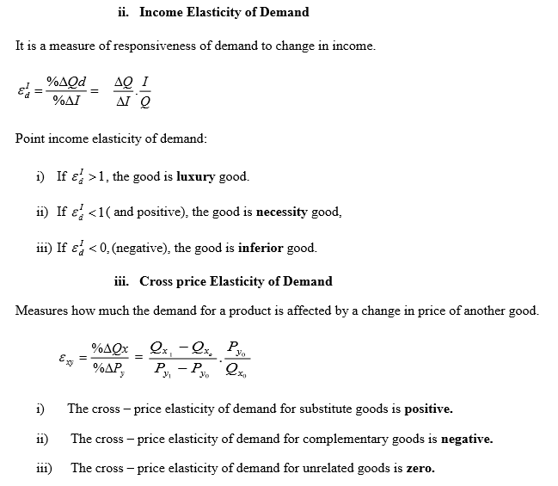

Slide 22
2.2 Theory of Supply
Supply indicates various quantities of a product that sellers (producers) are willing and able to provide at different prices in a given period of time, other things remaining unchanged
Note that supply shows a relationship between quantity supplied and price of a commodity, whereas
quantity supplied refers to a specific quantity which a producer is willing to sell at a specific price.
The law of supply: states that, ceteris paribus, there is a positive relationship between price and quantity supplied.

Slide 23
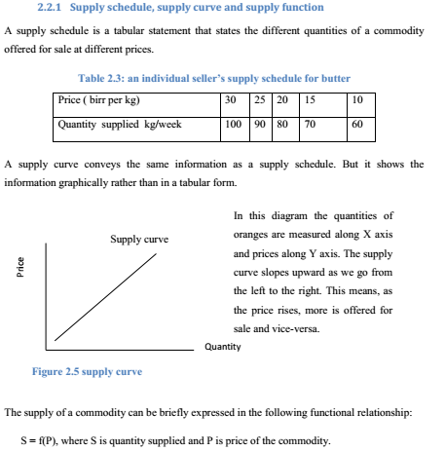

Slide 24
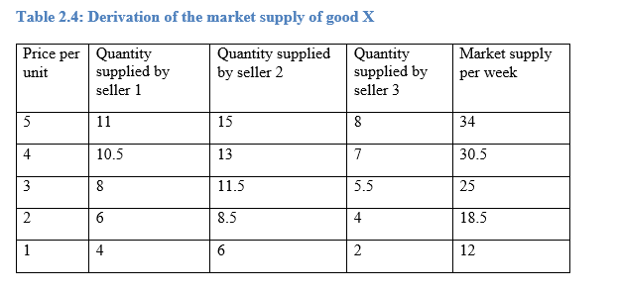
Individual Vs Market supply:
Individual supply refers to the different quantities of a commodity offered for sale by an individual firm at different prices per time period
Market supply is derived by horizontally adding the quantity supplied of the product by all sellers at each price.

Slide 25
Determinants of supply
i) price of the product
ii) price of inputs ( cost of inputs)
iii) technology
iv) prices of related goods
v) sellers‘ expectation of price of the product
vi) taxes & subsidies
vii) number of sellers in the market
viii) weather, etc.

Slide 26
i) Price – is the most important determinant
- Causes changes in quantity demanded
- movement along the supply curve
ii) input price
An increase in the price of inputs such as labour, raw materials, capital, etc causes a decrease in the supply of the product which is represented by a leftward shift of the supply curve.
iii) Technology
Technological advancement enables a firm to produce and supply more in the market. This shifts the supply curve outward.
iv) Effect of change in weather condition
other things remain unchanged, good weather condition boosts the supply of agricultural products. This shifts the supply curve of a given agricultural product outward.

Slide 27
v) Price of related goods
An increase in the price of other, related goods induces the firms to produce more of those other goods, leading to a reduction in the supply of the goods whose price has remained unchanged.
Vi) Taxes and subsidies
vii) Number of sellers
Viii) Sellers expectation of future prices

Slide 28
Elasticity of supply
Price elasticity of supply
the degree of responsiveness of the supply to change in price.
a percentage change in quantity supplied divided by the percentage change in price.
As the case with price elasticity of demand, we can measure the price elasticity of supply using point and arc elasticity methods.
However, a simple and most commonly used method is point method.

Slide 29
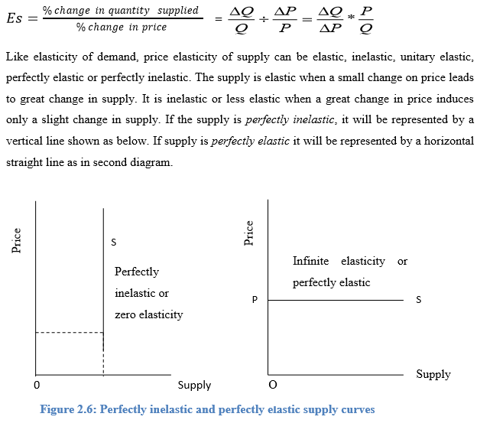

Slide 30
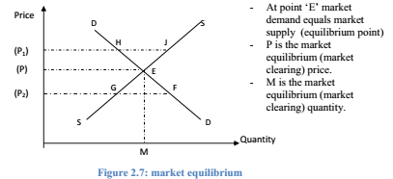
2.3 Market equilibrium
Having seen the demand and supply side of the market, now let‘s bring demand and supply together so as to see how the market price of a product is determined.
Market equilibrium occurs when market demand equals market supply.

Slide 31
In the above graph, any price greater than P will lead to market surplus. As the price of the commodity increases, consumers demand less of the product. On the other hand, as the price of increases, producers supply more of the good. Therefore, if price increases to P1 the market will have a surplus of HJ.
If the price decreases to P2 buyers demand to buy more and suppliers prefer to decrease their supply leading to shortage in the market which is equal to GF.
Numerical example:
Given market demand: Qd= 100-2P, and market supply: P =( Qs /2) + 10
a) Calculate the market equilibrium price and quantity
b) Determine, whether there is surplus or shortage at P= 25 and P= 35.

Slide 32
Effects of shift in demand and supply on equilibrium
Given demand and supply the equilibrium price and quantity are stable.
However, when these market forces change what will happen to the equilibrium price and quantity?
Changes in demand and supply bring about changes in the equilibrium price level and the equilibrium quantity.

Slide 33
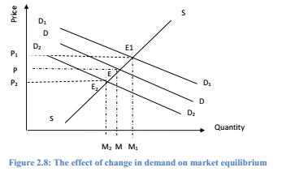
i. when demand changes and supply remains constant
Factors such as changes in income, tastes, and prices of related goods will lead to a change in demand.
Supply being given, a decrease in demand reduces both the equilibrium price and the quantity and vice versa.

Slide 34
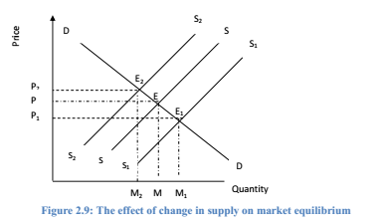
ii. When supply changes and demand remains constant
Changes in supply are brought by changes in technical knowledge and factor prices.
The following graph explains the effects of changes in supply.
Given the demand, increases in supply, reduces the equilibrium price and increases the equilibrium quantity.

Slide 35
III) Effects of combined changes in demand and supply
When both demand and supply increase, the quantity of the product will increase definitely.
But it is not certain whether the price will rise or fall. It depends on the strength of the relative changes in demand and supply.
If an increase in demand is more than an increase in supply, then the price goes up.
On the other hand, if an increase in supply is more than an increase in demand, the price falls but the quantity increases.
If the increase in demand and supply is same, then the price remains the same.

Slide 36
When demand and supply decline, the quantity decreases.
But the change in price will depend upon the relative fall in demand and supply.
When the fall in demand is more than the fall in supply, the price will decrease.
On the other hand, when the fall in supply is more than the fall in demand, the price will rise.
If both demand and supply decline in the same ratio, there is no change in the equilibrium price, but the quantity decreases.

Slide 37
END OF CHAPTER TWO

